Slide 1
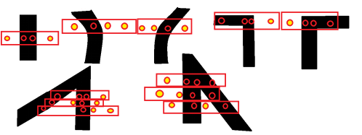
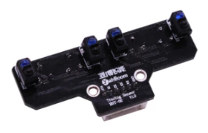
Tracking

Slide 2
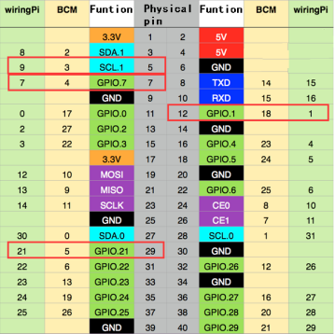
Left1 infrared sensor-----5(Physical pin)----- 9(wiringPi)
Left2 infrared sensor-----29(Physical pin)----- 21(wiringPi)
Right1 infrared sensor-----7(Physical pin)----- 7(wiringPi)
Right2 infrared sensor-----12(Physical pin)----- 1(wiringPi)
라인트레이킹 모듈 인터페이스

Slide 3
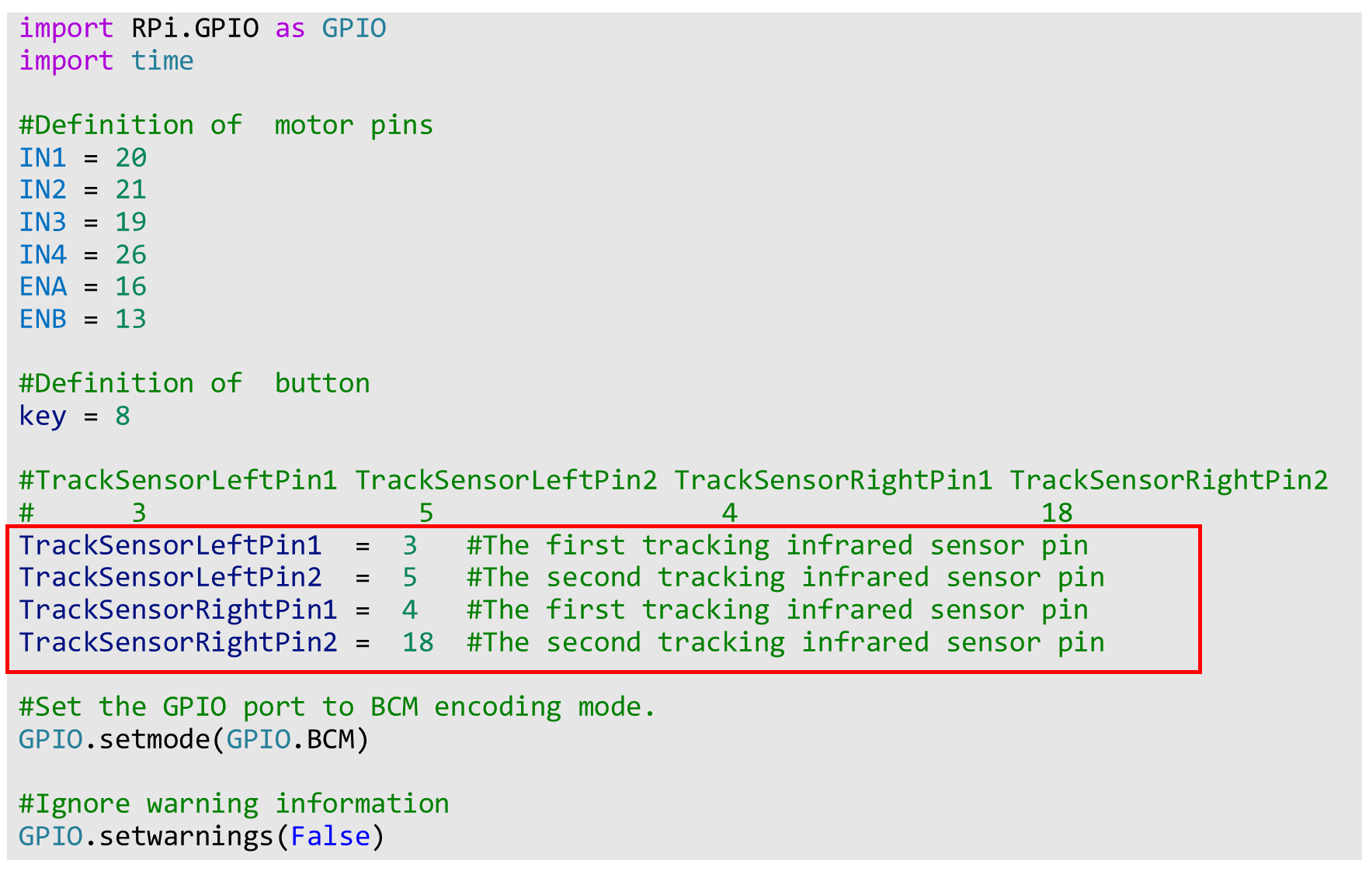

Slide 4
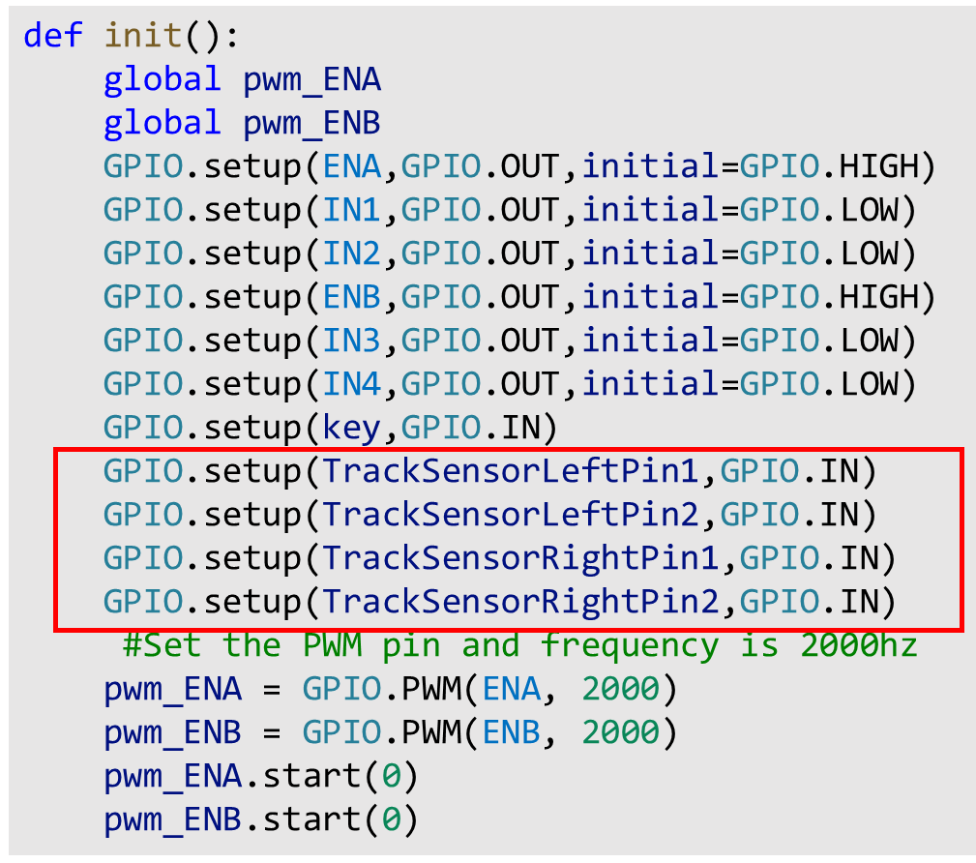

Slide 5
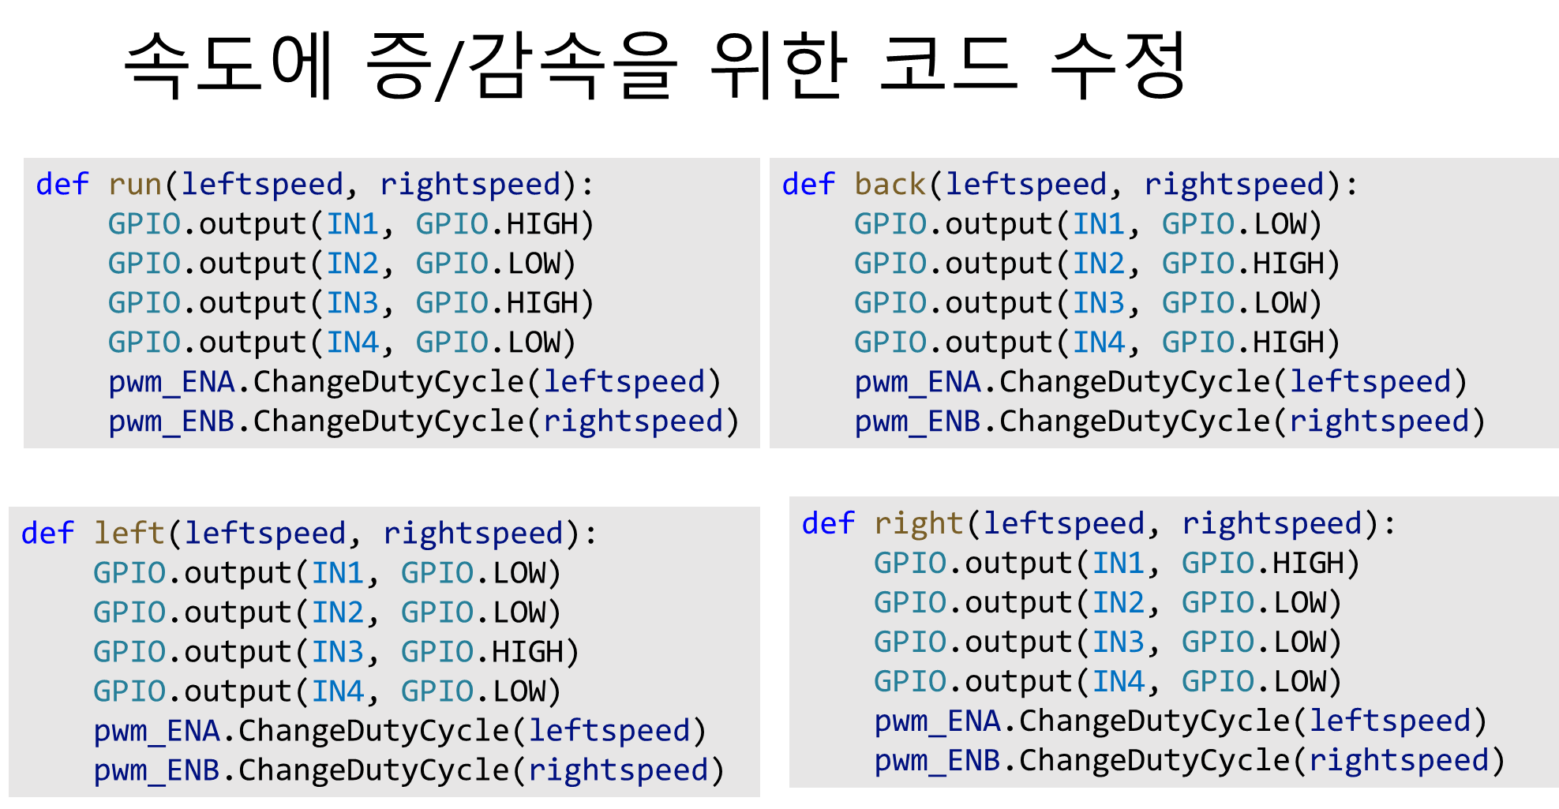

Slide 6
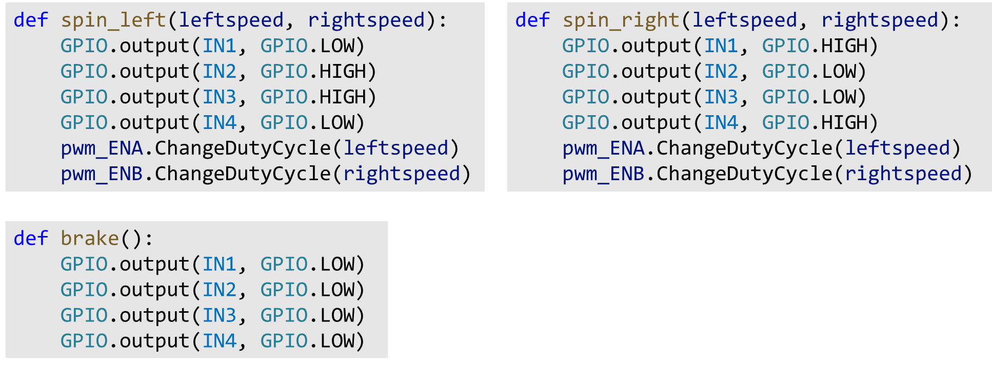

Slide 7
